Slide 1

STUDENT RESULT MANAGEMENT SYSTEM

Slide 2


Table of content
01. Abstract
02. Existing System
kjdjksd
03. System Requirements
04. Proposed System
05. Results
06. Conclusion
07. References

Slide 3


The project titled "STUDENT RESULT MANAGEMENT SYSTEM" is application developed to maintain the results of the students. a web based. This project contains three modules: register/login module, admin module and student module. Admin module is used to create and manage the subjects, classes and Add the students and their results. Student module used to provide the results of the students and can download the results. Registered users can access the database of the students. Which will provide details about subjects, classes, results, And student can download results.which is useful for the students.
Introduction

Slide 4

Introduction
Basic Concepts and Definitions
Student Result Management System: It is a web-based application designed to manage and maintain the results of students. The system provides functionalities for registering and logging in users, managing subjects and classes, and generating and downloading student results.
Modules: The system consists of three modules:
Register/Login Module: This module allows users to create an account and log in to the system.
Admin Module: The admin module is responsible for managing subjects, classes, and student records. Admins can add and update student information and results.
Student Module: The student module enables students to access their results and download them for future reference.
Database: The system utilizes a database to store and retrieve student information, subjects, classes, and results. It ensures efficient data management and retrieval.
User Access: Registered users, such as students and admin staff, have access to the system's database. They can view and interact with relevant information based on their assigned roles and permissions.
Please note that you can customize and expand on these concepts and definitions based on your specific project and its requirements.

Slide 5

EXISTING SYSTEM
Existing process of the getting information for the student is done manually.
All the wanted information need to be provided by the administration.
If the students want to know the results of the particular subject so their should wait for long time because work done manually.
The information about their courses, results and other information accessing is not possible.

Slide 6

System Requirements
Hardware Requirements
Software Requirements
Front-End Design:-HTML, CSS, JavaScript, Bootstrap
Back-End Database:-Microsoft SQL server, PHP

Slide 7
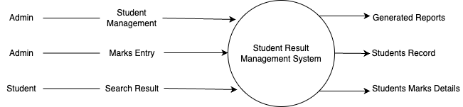
PROPOSED SYSTEM
We have successfully proposed the "STUDENT RESULT MANAGEMENT SYSTEM" for replacing the manual work of the administration.
By this application student can easily access the modules like student results and courses other information required to student.
This application is flexible and can easily access by the student.
So the time taken for getting the information will be reduces.

Slide 8
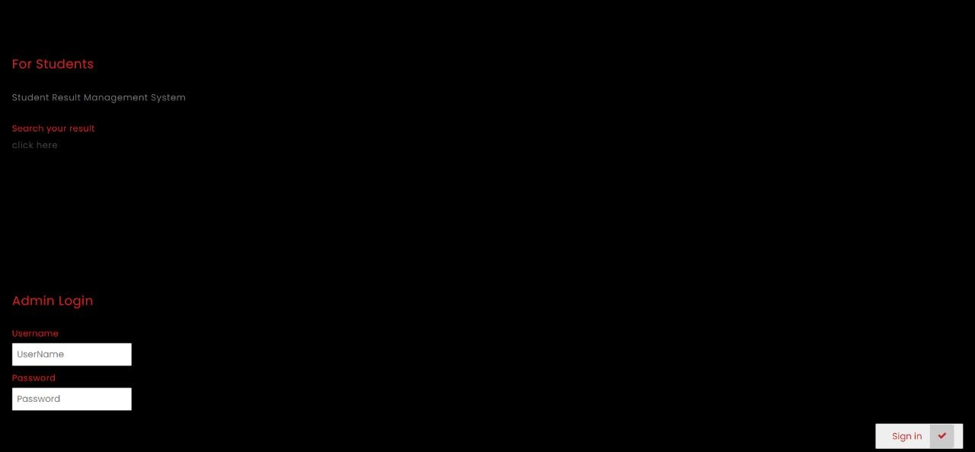
Results/Performance Evaluation
1. Login Page

Slide 9
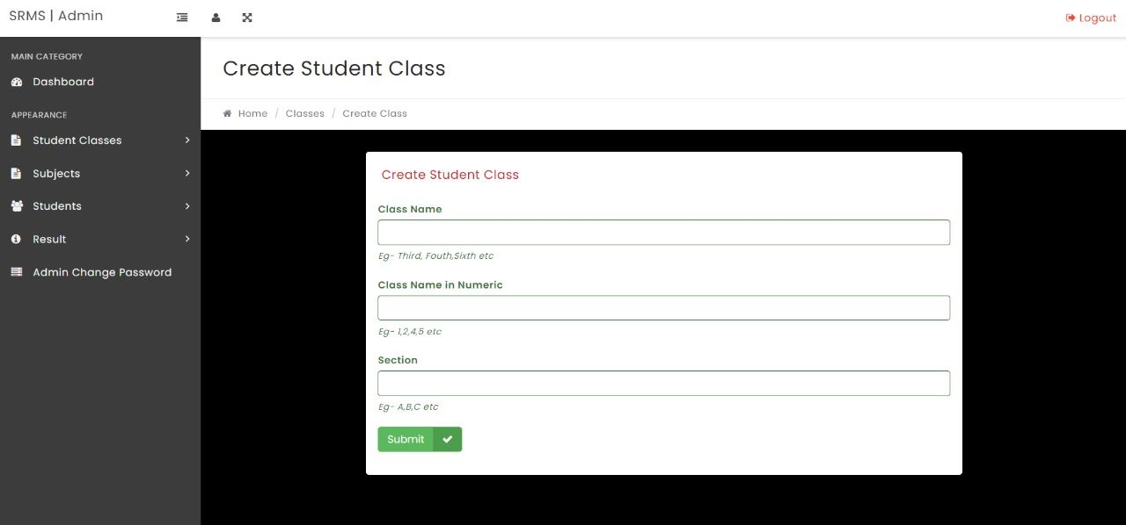
Results/Performance Evaluation
2. Create Student Class

Slide 10
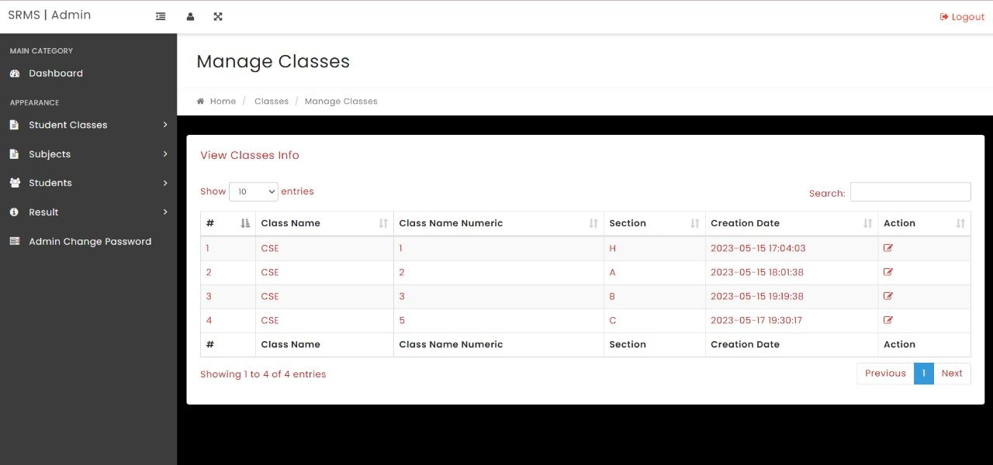
Results/Performance Evaluation
3. Manage Classes

Slide 11
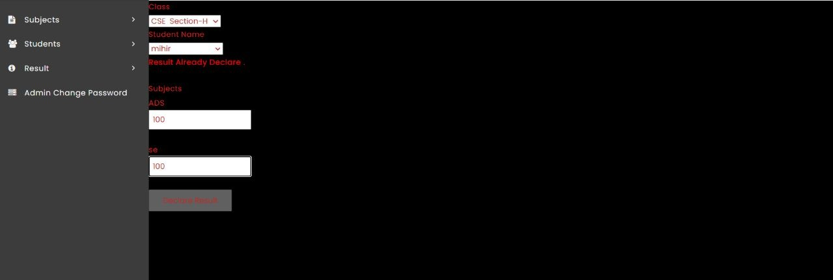
Results/Performance Evaluation
4. Declare Result

Slide 12
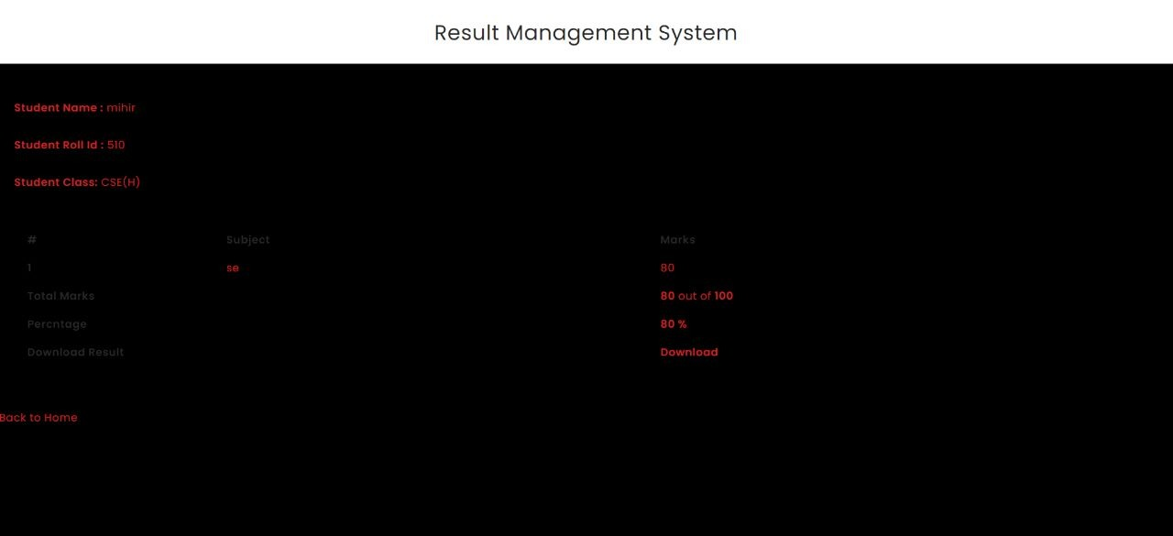
Results/Performance Evaluation
5. Result Page

Slide 13
CONCLUSION
The package was designed in such a way that future modifications can be done easily. The following conclusions can be deduced from the development of the project.
Automation of the entire system improves the efficiency.
It provides a friendly graphical user interface which proves to be better when compared to the existing system.
It gives appropriate access to the authorized users depending on their permissions.
It effectively overcomes the delay in communications.
Updating of information becomes so easier. System security, data security and reliability are the striking features.
The System has adequate scope for modification it future if it is necessary.

Slide 14
References :
PHP and MySQL Web Development, Book by Luke Welling
Head First PHP & MySQLBook by Lynn Beighley and Michael Morrison
PHP & MySQL for Dummies, book by Janet Valade
www.w3schools.com
www.tutorialspoint.php
http://stackoverflow.com
Pearson. Wallace, P. (2015). Introduction to Information Systems (2nd ed.). Boston: Pearson Wundenberg. S-M (2015). Requirement Engineering for Knowledge-Intensive Processes: Reference Architecture for the Selection of a Learning Management System, Wiesbaden Germany Springer Gabler. https://doi.org/10.1007/978-3-658-08832-3

Slide 15

Team :
Karthik Dasari (AP20110010501)
Venkata Naga Kalyan Puppala (AP20110010509)
Mihir Krishna Tatavarthi (AP20110010510)
Vyshnavi Yakkanti (AP20110010559)
THANKYOU

